Slide 1

A Density-Based Algorithm For Discovering Clusters In Large Spatial Databases
Jiayu Gao
Saisrikar Paruchuri
Roshan Bagla
Leopold Fournier
Chuan Leong Foo

Slide 2
Index
Introduction
Clustering Algorithm
DBSCAN Algorithm
Performance Evaluation
Conclusions

Slide 3
Introduction
Discovering Clusters in Spatial Databases.
A Spatial Database is large amount of space related data such as maps, medical images data, X-ray crystallography etc.
Clustering Algorithms are used in class identification of an object. Examples: K-means algorithm, K-medoid algorithms, CLARANS and DBSCAN
Discussing concepts of CLARANS and DBSCAN.

Slide 4
Introduction
Requirements of clustering algorithm:
a domain knowledge.
Minimal Input parameters.
Arbitrary Shape of clusters.
Effective and Efficient on large data sets.
Existing algorithm offers no solution to these requirements.
DBSCAN requires only one input parameter i.e. k, by using the concept of density.

Slide 5
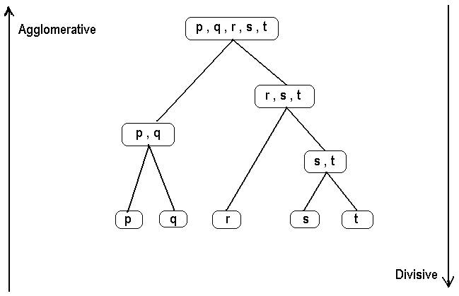
Clustering Algorithm
Partitioning and Hierarchical are two basic clustering algorithms.
Partitioning algorithm includes K-means and K-medoid.
Agglomerative and divisive approach are types of Hierarchical algorithm.

Slide 6
CLARANS
CLARANS is another clustering algorithm.
Clustering large applications based on randomized search.
Improved version of k-medoid.
Run time of O(n) of CLARANS is very high on large data sets.
Therefore, DBSCAN was introduced.

Slide 7
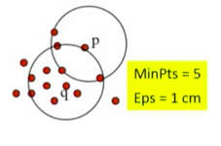
DBSCAN: Density-Based Spatial Clustering Algorithm
DBSCAN (M. Ester, H.-P. Kriegel, J.sander, and X.Xu, KDD’96)
Discovers clusters of arbitrary shape : Density-Based Spatial Clustering of Applications with Noise.
A density based notion of clusters.
Two parameters:
Eps-neighborhood: Maximum radius of the neighborhood.
MinPts: Minimum number of points in the Eps-neighborhood of a point.
The Eps-neighborhood of a point q:
N_{EPS}(q): { p belongs to D | dist(p,q) <=Eps}

Slide 8
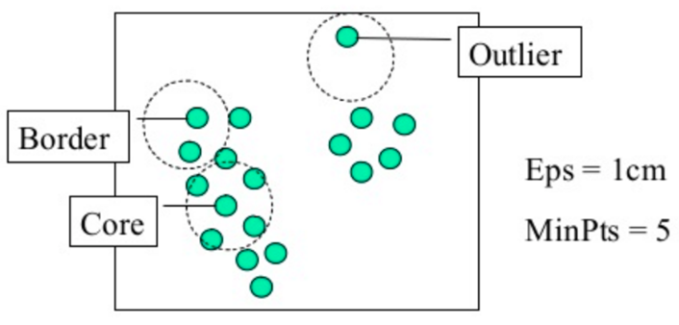
DBSCAN
Core Points: Dense neighborhood.
Border Point: In cluster but neighborhood is not dense.
Outlier/noise: Not in cluster.

Slide 9
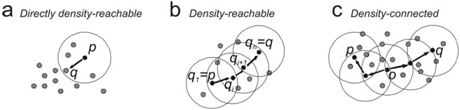
DBSCAN
Directly density-reachable
A point p is directly density-reachable from a point q w.r.t Eps, MinPts if
P belongs to N_{Eps} (q)
Core point condition: |N_{eps}(q)|>= MinPts
Density-reachable
A point p is density-reachable from a point q w.r.t Eps, MinPts if there is a chain of points p₁,...,p_{n}, p1=q, p_{n}=p such that p_{i+1} is directly density-reachable from p_{i.}
Density-connected
A point p is density-connected to a point q w.r.t Eps, MinPts if there is a point o such that both p and q are density-reachable from o w.r.t Eps and MinPts.

Slide 10
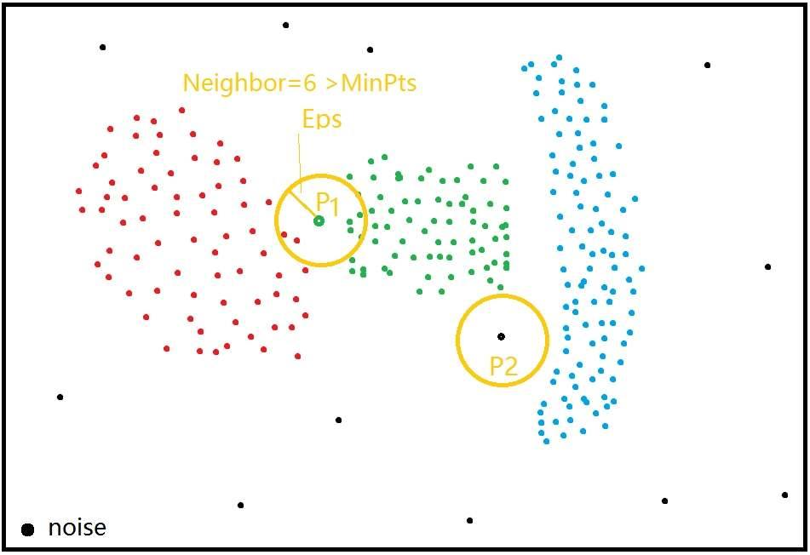
DBSCAN Algorithm
Select an arbitrary point p from unclassified set.
Retrieve all points that are density-reachable from point p w.r.t Eps and MinPts.
A cluster is formed, if p is a core point.
No points are density-reachable from p if p is a border point. DBSCAN will visit next point of database.
Iterate the process until all points have been processed.

Slide 11
DBSCAN Algorithm

Slide 12
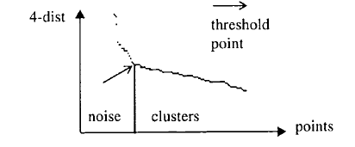
Determining the Eps & MinPts
K-dist: The distance of each point to its k-th nearest neighbor.
Eps = k-dist(p) MinPts = k
Approach:
Computing and display 4-dist graph(4 is most ideal number).
Estimate percentage of noise to derive a proposal for the threshold.
Threshold = Eps.

Slide 13
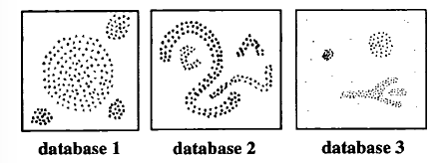
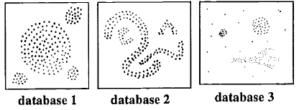
Performance Evaluation CLARANS vs DBSCAN (C++, R*-Tree)
Effectivity (Evaluated by visual inspection)
Results:
DBSCAN: Detects the noise points
CLARANS: No explicit notion of noise
Clustering Discovered by DBSCAN
Clustering Discovered by CLARANS

Slide 14
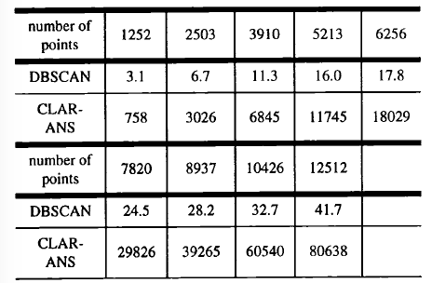
Performance Evaluation
Efficiency (Compare the run time in seconds)
Results:
DBSCAN: Slightly higher than linear
CLARANS: Close to quadratic

Slide 15
Conclusions
DBSCAN uses only one input parameter – k, and supports users in defining it.
DBSCAN is suitable for computing in large spatial databases.
DBSCAN is more effective in finding the clusters of arbitrary shapes than CLARANS.
In terms of efficiency, DBSCAN outperforms CLARANS at least by a factor of 100.

Slide 16
END

